Slide 1
Automated trading of black box events.
Alexey Osipov

Slide 2
Setting (playing a betting company).
One event: several random outcomes.
Just initial probabilities given by an oracle.
Non-life event.
People are making orders and bets on random outcomes by prices.
Money is distributed when the true outcomes become clear.
Rentability is fixed.
Goal: refine initial probabilities basing on bets (and offer prices).
Alternative goal: move prices so that we do not loose.

Slide 3
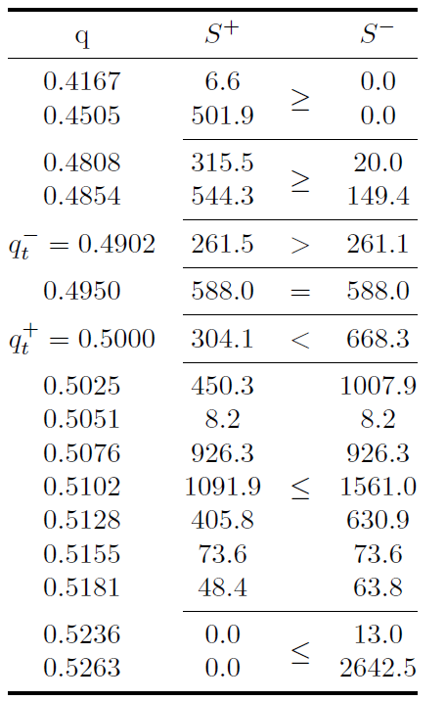
Example of order book.

Slide 4
Betfair as prediction market.
People are making bets with each other.
At some point the price stabilizes.
Bid-ask spread can be good.
The prices are used by betting companies.
The stabilized price is a fair price.

Slide 5

Assumptions.
People have different probability estimates of the outcomes.
People are risk-seekers (betting).
The probability estimates are different because people have different information.
People can share the information both via bets and by publishing.
The probabilities are from
We want to estimate the median \mu.

Slide 6

Utility function of the experts.
M_L and m_L are maximal and minima possessions, b is budget.
\lambda is risk attitude (depends on time).

Slide 7
Reasoning.
People are making bets maximizing the utility function.
Fix t.
Fix \lambda. Find \mu(\lambda) and \sigma(\lambda) optimizing the log likelihood.
Find \lambda as a solution of the equilibrium equation based on \mu(\lambda) and \sigma(\lambda).
Once \lambda_t has been found, find \mu and \sigma_t optimizing the log-likelihood.
The numerical method is L-BFGS-B.

Slide 8
Expectations.
The estimate of \mu should approach the last price.
We should be estimating the median of probabilities.
The variance should decrease.
Ideally, we should know the last price long before it stabilizes.

Slide 9
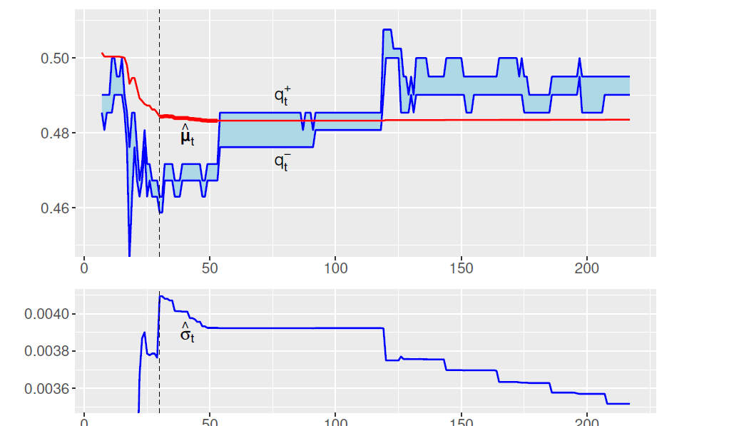
One good example (more in demo).

Slide 10
Other approaches.
Geometrical algorithm for choosing the prices basing on rentability. Basically, construction of a surface.
If we had a model, we could have refined it basing on bets.
It is possible to construct a market maker that just flies with the flow.
We could take into account messages in the chat.

Slide 11
Applications to insurance.
Peer-to-peer insurance (P2P).
Way of determining the probabilities of events together.
The group may be not so large.

Slide 12
Demo.
Let us try to play with the data!

